Slide 1

Dr. Anil K Ahlawat
Professor, KIET Group of Institutions

Slide 2

Well defined learning problems
Designing a Learning System
Issues in Machine Learning

Slide 3

Ever since computers were invented, we have wondered whether they might be made to learn.
If we could understand how to program them to learn-to improve automatically with experience-the impact would be dramatic.
Imagine computers learning from medical records which treatments are most effective for new diseases,

Slide 4
houses learning from experience to optimize energy costs based on the particular usage patterns of their occupants,
or personal software assistants learning the evolving interests of their users in order to highlight especially relevant stories from the online morning newspaper.
A successful understanding of how to make computers learn would open up many new uses of computers and new levels of competence and customization.

Slide 5

A computer program is said to learn from experience E with respect to some class of tasks T and performance measure P, if its performance at tasks in T, as measured by P, improves with experience E.
Example : Checkers, Chess
For example, a computer program that learns to play checkers might improve its performance as measured by its ability to win at the class of tasks involving playing checkers games, through experience obtained by playing games against itself.

Slide 6
In general, to have a well-defined learning problem, we must identity these three features:
  the class of tasks,
  the measure of performance to be improved, and
  the source of experience

Slide 7
We can specify many learning problems in this fashion,
  such as learning to recognize handwritten words,
  or learning to drive a robotic automobile autonomously.

Slide 8
A robot driving learning problem:
  Task T: driving on public four-lane highways using vision sensors
  Performance measure P: average distance traveled before an error (as judged by human overseer)
  Training experience E: a sequence of images and steering commands recorded while observing a human driver

Slide 9
A checkers learning problem:
  Task T: playing checkers
  Performance measure P: percent of games won against opponents
  Training experience E: playing practice games against itself

Slide 10
A handwriting recognition learning problem:
  Task T: recognizing and classifying handwritten words within images
  Performance measure P: percent of words correctly classified
  Training experience E: a database of handwritten words with given classifications

Slide 11
Chess game: –
  Task T: playing chess games
  Performance measure P: percent of games won against opponents
  Training experience E: playing practice games against itself

Slide 12

Learning to recognize spoken words
  All of the most successful speech recognition systems employ machine learning in some form.
  For example, the SPHINXsy stem (e.g., Lee 1989) learns speaker-specific strategies for recognizing the primitive sounds (phonemes) and words from the observed speech signal.
  Neural network learning methods (e.g., Waibel et al. 1989) and methods for learning hidden Markov models (e.g., Lee 1989) are effective for automatically customizing to, individual speakers, vocabularies, microphone characteristics, background noise, etc.

Slide 13
Learning to drive an autonomous vehicle
  Machine learning methods have been used to train computer-controlled vehicles to steer correctly when driving on a variety of road types.
  For example, the ALVINN system (Pomerleau 1989) has used its learned strategies to drive unassisted at 70 miles per hour for 90 miles on public highways among other cars.

Slide 14
Learning to classify new astronomical structures
  Machine learning methods have been applied to a variety of large databases to learn general regularities implicit in the data.
  For example, decision tree learning algorithms have been used by NASA to learn how to classify celestial objects from the second Palomar Observatory Sky Survey (Fayyad et al. 1995).
  This system is now used to automatically classify all objects in the Sky Survey, which consists of three terra bytes of image data.

Slide 15
Learning to play world-class backgammon
  The most successful computer programs for playing games such as backgammon are based on machine learning algorithms.
  For example, the world's top computer program for backgammon, TD-GAMMON(Tesauro 1992, 1995). learned its strategy by playing over one million practice games against itself.

Slide 16
Learning to play world-class backgammon
  It now plays at a level competitive with the human world champion.
  Similar techniques have applications in many practical problems where very large search spaces must be examined efficiently

Slide 17

Choosing the training experience: –
  Direct or indirect feedback
  Degree of learner's control
  Representative distribution of examples

Slide 18
Choosing the target function: –
  Type of knowledge to be learned
  Function approximation

Slide 19
Choosing a representation for the target function: –
  Expressive representation for a close function approximation
  Simple representation for simple training data and learning algorithms
Choosing a function approximation algorithm (learning algorithm)

Slide 20

Consider designing a program to learn to play checkers, with the goal of entering it in the world checkers tournament
Requires the following sets
  Choosing Training Experience
  Choosing the Target Function
  Choosing the Representation of the Target Function
  Choosing the Function Approximation Algorithm

Slide 21

Will the training experience provide direct or indirect feedback?
  Direct Feedback: System learns from examples of individual checkers board states and the correct move for each
  Indirect Feedback: Move sequences and final outcomes of various games played
    Credit assignment problem: Value of early states must be inferred from the outcome
Notes:
which sequence of moves take credit or blame for the final outcome
Particularly difficult because game can be lost even when early moves are optimal, if there are poor moves later
Direct feedback easier to learn from

Slide 22
Degree to which the learner controls the sequence of training examples
  Teacher selects informative boards and gives correct move
  Learner proposes board states that it finds particularly confusing. Teacher provides correct moves
  Learner controls board states and (indirect) training classifications
Notes:
which sequence of moves take credit or blame for the final outcome
Particularly difficult because game can be lost even when early moves are optimal, if there are poor moves later
Direct feedback easier to learn from

Slide 23
How well the training experience represents the distribution of examples over which the final system performance P will be measured
  If training the checkers program consists only of experiences played against itself, it may never encounter crucial board states that are likely to be played by the human checkers champion
  Most theory of machine learning rests on the assumption that the distribution of training examples is identical to the distribution of test examples
Notes:
Obvious danger that this training experience might not be fully representative of the distribution of situations over which it will later be tested
Champion does not have time to train the system
Assumption is often violated in practice – can't apply theoretical results to the system

Slide 24

A checkers learning problem:
  Task T: playing checkers
  Performance measure P: percent of games won in the world tournament
  Training experience E: games played against itself
Remaining choices
  The exact type of knowledge to be learned
  A representation for this target knowledge
  A learning mechanism

Slide 25

Assume that you can determine legal moves
Program needs to learn the best move from among legal moves
  Defines large search space known a priori
  target function: ChooseMove : B → M
ChooseMove is difficult to learn given indirect training
Notes:
Determine exactly what type of knowledge will be learned and how this will be used by the performance program
obvious choose of information to be learned is a program, or function, that chooses the best move from a given board state
Functions assigns higher scores to better board positions

Slide 26

Alternative target function
  An evaluation function that assigns a numerical score to any given board state
  V : B → ( where is the set of real numbers)
    V(b) for an arbitrary board state b in B
      if b is a final board state that is won, then V(b) = 100
      if b is a final board state that is lost, then V(b) = -100
      if b is a final board state that is drawn, then V(b) = 0
      if b is not a final state, then V(b) = V(b '), where b' is the best final board state that can be achieved starting from b and playing optimally until the end of the game
Notes:
Determine exactly what type of knowledge will be learned and how this will be used by the performance program
obvious choose of information to be learned is a program, or function, that chooses the best move from a given board state
Functions assigns higher scores to better board positions

Slide 27


V(b) gives a recursive definition for board state b
  Not usable because not efficient to compute except is first three trivial cases
  Non operational definition
Goal of learning is to discover an operational description of V
Learning the target function is often called function approximation
  Referred to as
Notes:
Difficult to learn an operational form of V perfectly
Expect learning algorithms to acquire only some approximation to the target function

Slide 28

Choice of representations involve trade offs
  Pick a very expressive representation to allow close approximation to the ideal target function V
  More expressive, more training data required to choose among alternative hypotheses
Notes:
V hat can be represented using a large table with distinct entry specifying the value for each distinct board state
Collection of rules that match against features of the board state
Quadratic polynomial function of predefined board features
neural network

Slide 29
Use linear combination of the following board features:
  x₁: the number of black pieces on the board
  x₂: the number of red pieces on the board
  x₃: the number of black kings on the board
  x₄: the number of red kings on the board
  x₅: the number of black pieces threatened by red (i.e. which can be captured on red's next turn)
  x₆: the number of red pieces threatened by black
Notes:
V hat can be represented using a large table with distinct entry specifying the value for each distinct board state
Collection of rules that match against features of the board state
Quadratic polynomial function of predefined board features
neural network

Slide 30

A checkers learning problem:
  Task T: playing checkers
  Performance measure P: percent of games won in the world tournament
  Training experience E: games played against itself
  Target Function: V: Board →
  Target function representation

Slide 31

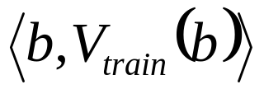
To learn we require a set of training examples describing the board b and the training value V_{train}(b)
  Ordered pair

Slide 32

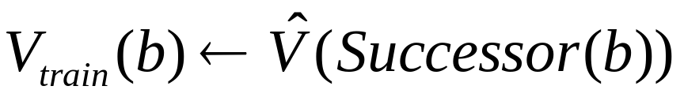
Need to assign specific scores to intermediate board states
Approximate intermediate board state b using the learner's current approximation of the next board state following b
  Simple and successful approach
  More accurate for states closer to end states
Notes:
Can be proven to converge toward perfect estimates of Vtrain

Slide 33

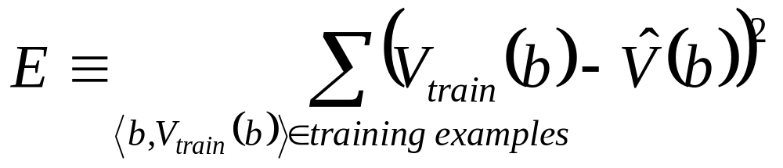
Choose the weights w_{i} to best fit the set of training examples
Minimize the squared error E between the train values and the values predicted by the hypothesis
Require an algorithm that
  will incrementally refine weights as new training examples become available
  will be robust to errors in these estimated training values
Least Mean Squares (LMS) is one such algorithm

Slide 34

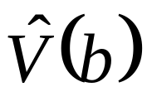
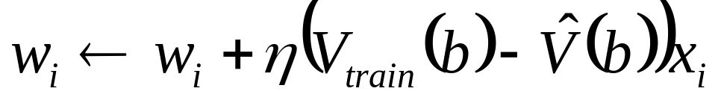

For each train example
  Use the current weights to calculate
  For each weight w_{i}, update it as
  Where
    is a small constant (e.g. 0.1)
Notes:
when Vtrain(b) and Vhat are zero no weights change
xi is zero weight stays the same
converges to the least squared error

Slide 35



Experiment
Generator
New problem
(initial game board)
Hypothesis
Performance
System
Generalizer
Solution trace
(game history)
Training examples
Critic
Notes:
Performance System – module that must solve the given performance task – using the learned target function(s)
new game as input
produces trace of solution – use Vhat so performance should improve over time
Critic – produces set of training examples of the target functions Vtrain is Vhat(successor of b)
Generalizer – output hypothesis that is its estimate of the target function
Should cover the examples, and other cases (generalizing) – LMS algorithm – outputs the weights
Experiment Generator – outputs a new problem
Pick new practice problems that will maximize the learning rate of the overall system
Example proposes the same initial game board

Slide 36

Determine Type
of Training Experience
Games against
Experts
Games against itself
Table of
correct Moves
Determine
Target Function
…
…
Board → move
Board → value
Determine Representation
of Learned Function
Polynomial
Artificial neural
network
Linear function of six features
…
Determine
Learning Algorithm
Gradient descent
Linear Programming
…
Complete Design
Notes:
Produces a specific instantiation for each of the parts in the final design
Design choices constrained the learning task
restricted knowledge to single linear evaluation function
depends on 6 board features
if true V not represented by the features then best we can hope is that is will learn a good approximation – can't learn anything it does not represent
Probably couldn't beat human checkers champion because function too simple
Similar design for a backgammon game (learning a similar evaluation function)– trained on over 1 million self-generated training games, and then played very competitively with top-ranked human backgammon players

Slide 37

Chess game: –
  Task T: playing chess games
  Performance measure P: percent of games won against opponents
  Training experience E: playing practice games against itself
  Target function: V: Board → R

Slide 38
Chess game: –
  Target function representation:
  V ^(b) = w₀ + w₁x₁ + w₂x₂ + w₃x₃ + w₄x₄ + w₅x₅ + w₆x₆
  x₁: the number of black pieces on the board
  x₂: the number of white pieces on the board
  x₃: the number of black kings on the board
  x₄: the number of white kings on the board
  x₅: the number of black pieces threatened by red
  x₆: the number of white pieces threatened by black

Slide 39
Chess game: –
  Function approximation algorithm:
  (< x₁ = 3, x₂ = 0, x₃ = 1, x₄ = 0, x₅ = 0, x₆ = 0>, 100)
  x₁: the number of black pieces on the board
  x₂: the number of white pieces on the board
  x₃: the number of black kings on the board
  x₄: the number of white kings on the board
  x₅: the number of black pieces threatened by red
  x₆: the number of white pieces threatened by black

Slide 40
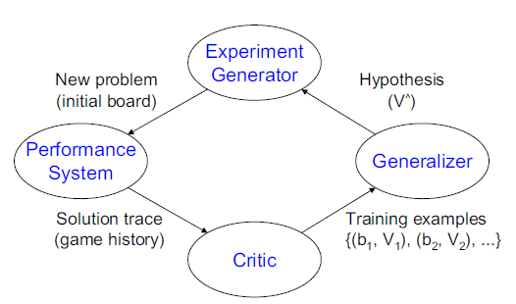
What is learning ?
  Learning is an (endless) generalization or induction process.

Slide 41
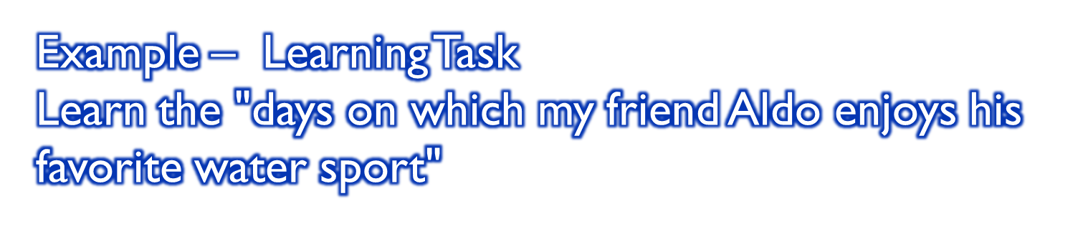
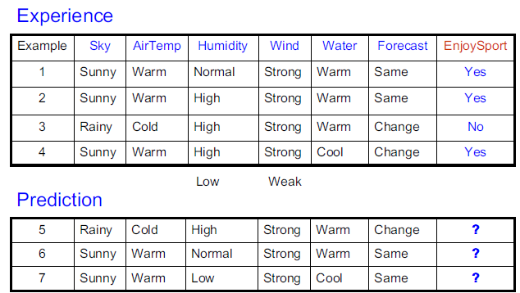

Slide 42

What learning algorithms to be used?
How much training data is sufficient?
When and how prior knowledge can guide the learning process?
What is the best strategy for choosing a next training experience?
What is the best way to reduce the learning task to one or more function approximation problems?
How can the learner automatically alter its representation to improve its learning ability?

